Slide 1
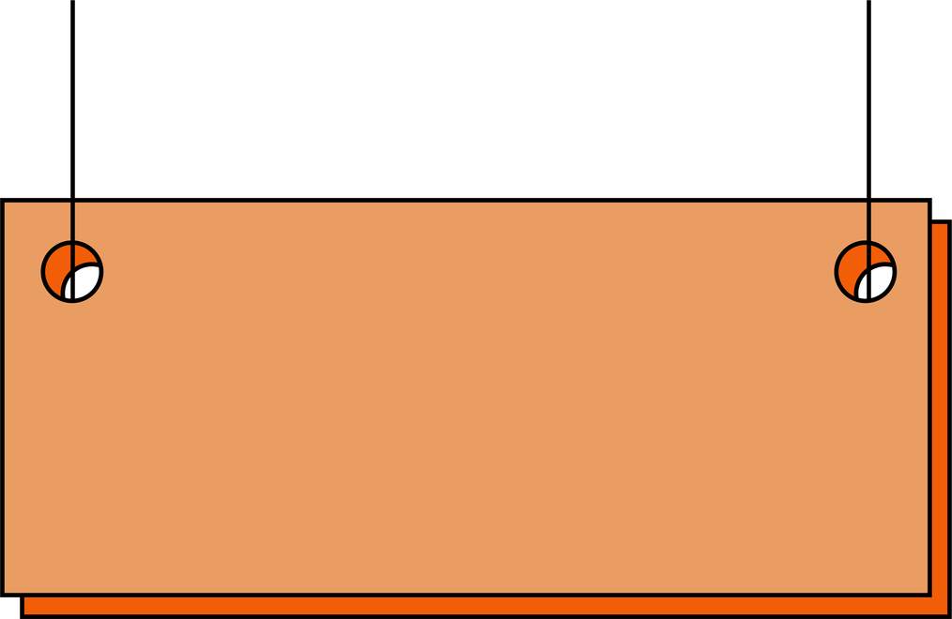
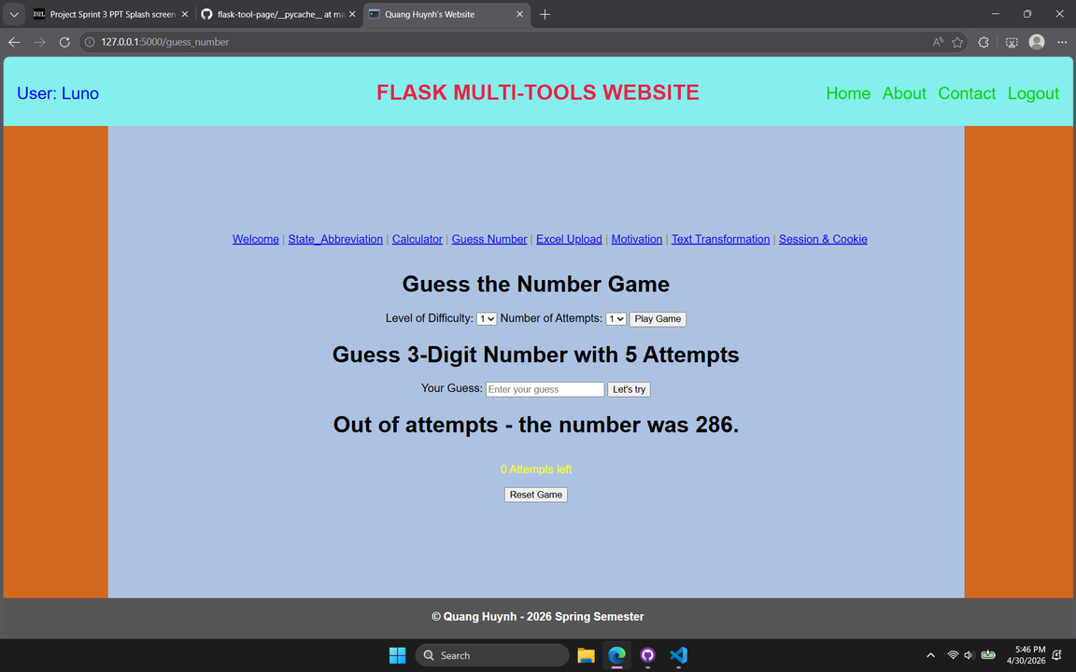

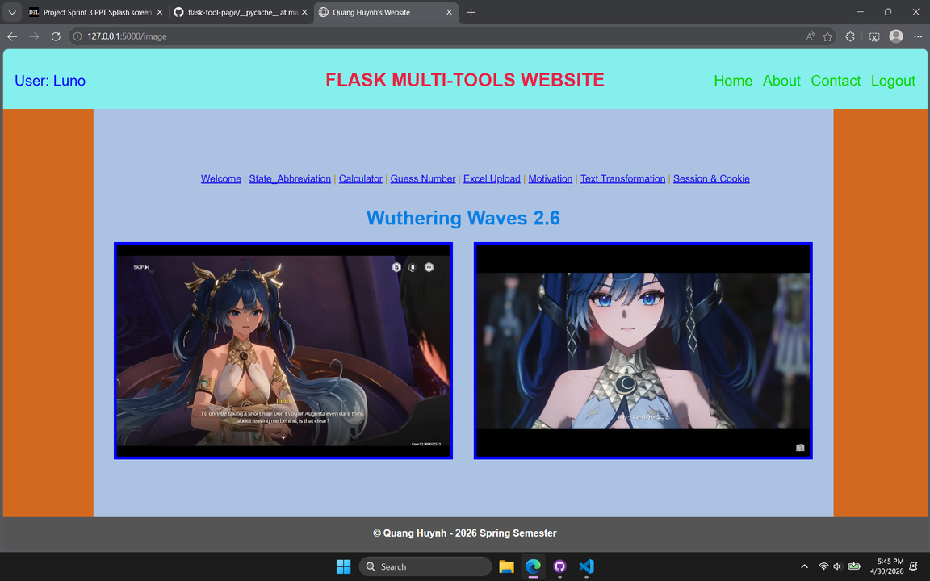
Flask-Multi-Tools Webpage
Project is developed by
Quang Huynh
A webserver running on local machine
Webpage contains tabs for simple tools:
Welcome
State abbreviation convertor
Simple calculator
Guessing-number game
Excel-upload display
Motivation images
Text transformation
Sessions-cookies display
Flask Microweb- Framwork Project
Web also incorporate menu on top right corner:
"Home": return to homepage
"About": the purpose of the webpage
"Contact": for feedbacks and recommendations
“Login”: for simple user verification (though not recommended for credential storage in real production => SQLite, MySQl the way to go)

